Slide 1
Senior Project
Trevor Engstrom

Slide 2
Overview
Project is a web app for a commercial truck dealer in Fort Myers Florida

Slide 3
Client
Todd Allan Motors
Clients Requirements:
Easy to use / Hard to mess up
Cheap to maintain
Makes the dealership look professional
Solution:
Website
Display’s inventory
Allows client to maintain inventory
Allows client to upload and display information on inventory
store and display photos
Able to contact the dealership from website

Slide 4
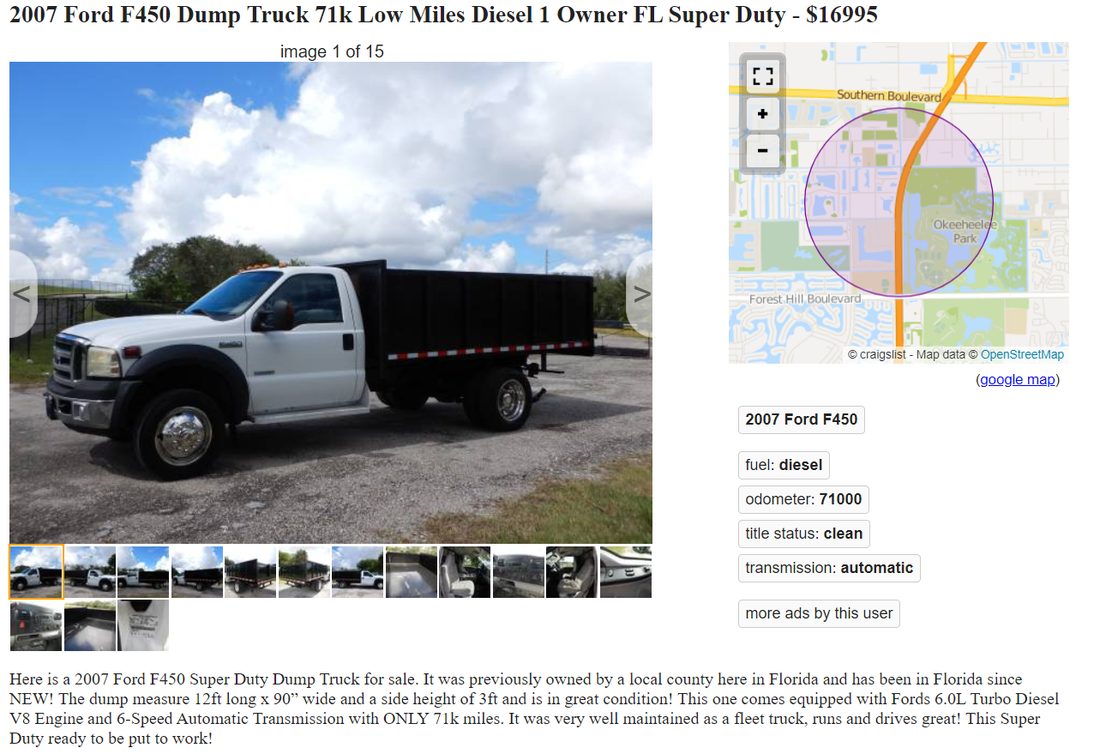
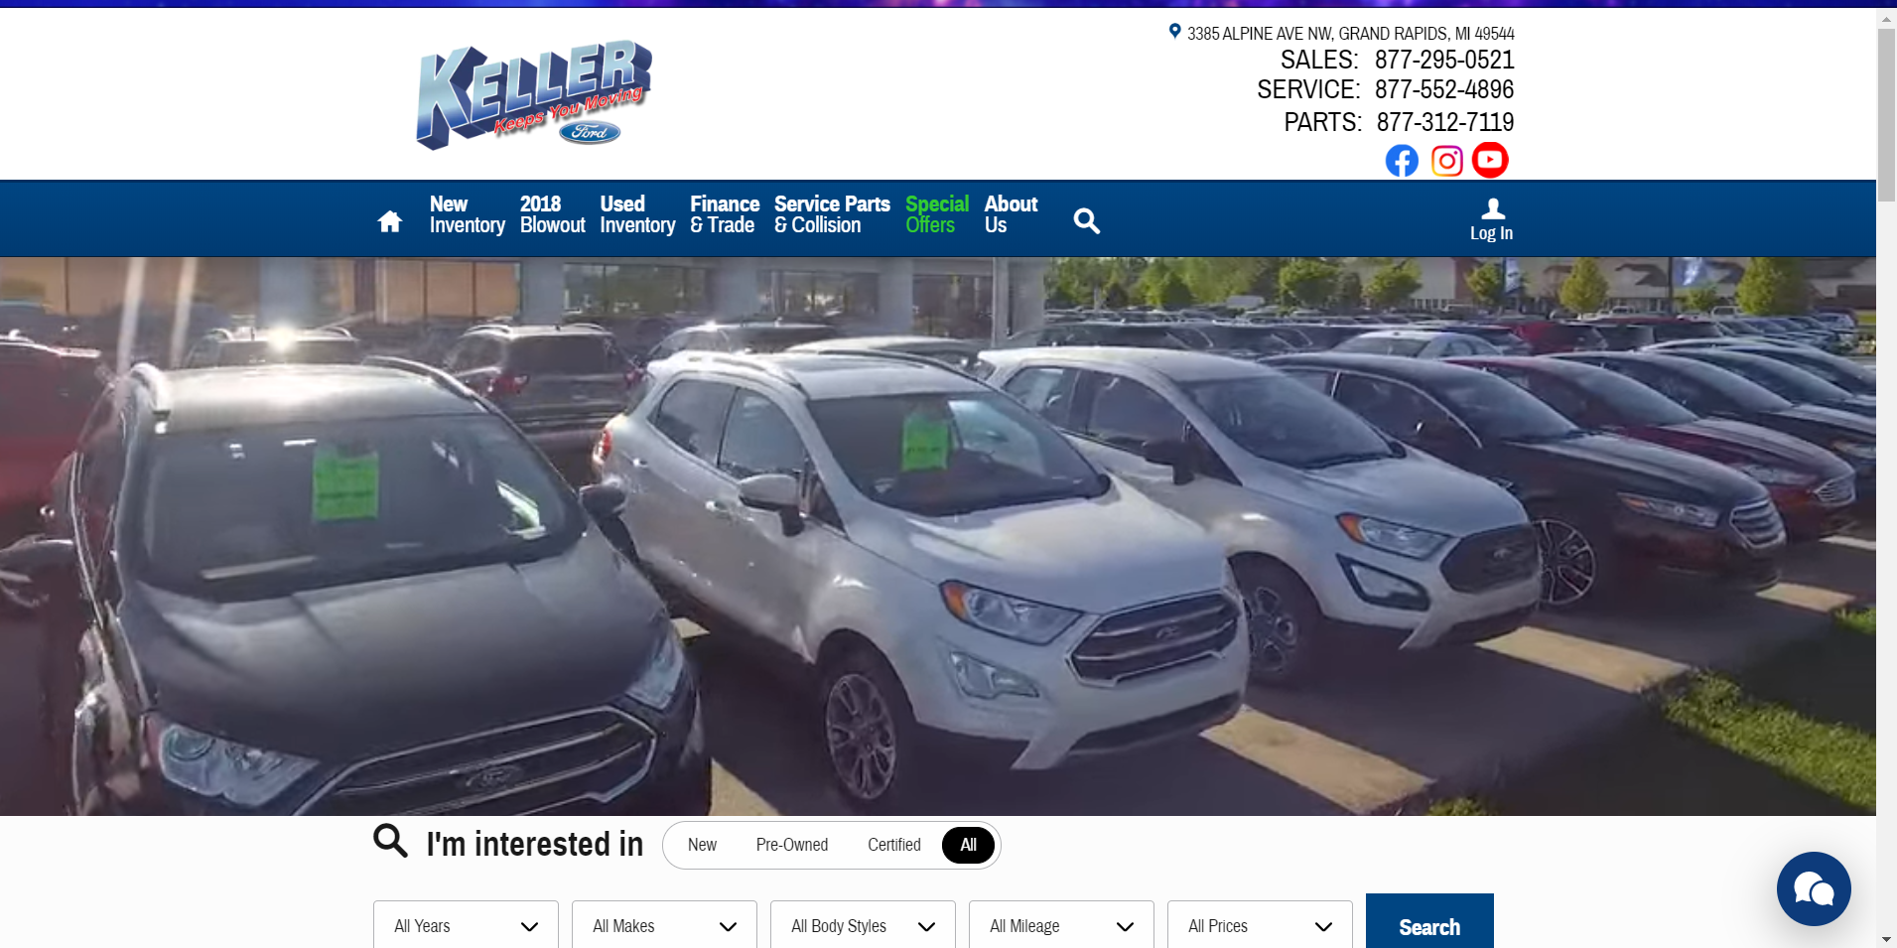
Main Objectives

Slide 5
Project Requirements
Front End Design
Landing Page
About Us
Contact Us
Inventory
Datatable
Partial View for vehicle
Sell / Trade In
Financing
Dashboard
Roles
Login system
Show/Hide
Dashboard
Inventory CRUD
Photo CRUD
Database Design
Inventory Table
Photo Table
Photo Lookup Table
Back End
Entity Framework
Hosting
Server
Domain Registration

Slide 6
Methodology
ASP.NET Model View Controller
Visual Studio / C#
Javascript
Vue JS Framework
Ajax / JSON
Datatables
JQuery
Dropzone.JS
HTML / CSS
Bootstrap
SQL Server
Entity Framework
Linq

Slide 7
Timeline
Complete Log in / Roles / Access (Early November)
Complete database design (Early November)
Complete Dashboard CRUD (Mid November)
Complete Inventory Detail Page (Late November)
Complete Front End Design (Late November / Early December)
Testing / Server Tests (Early December)
Full Launch ( Mid December)

Slide 8
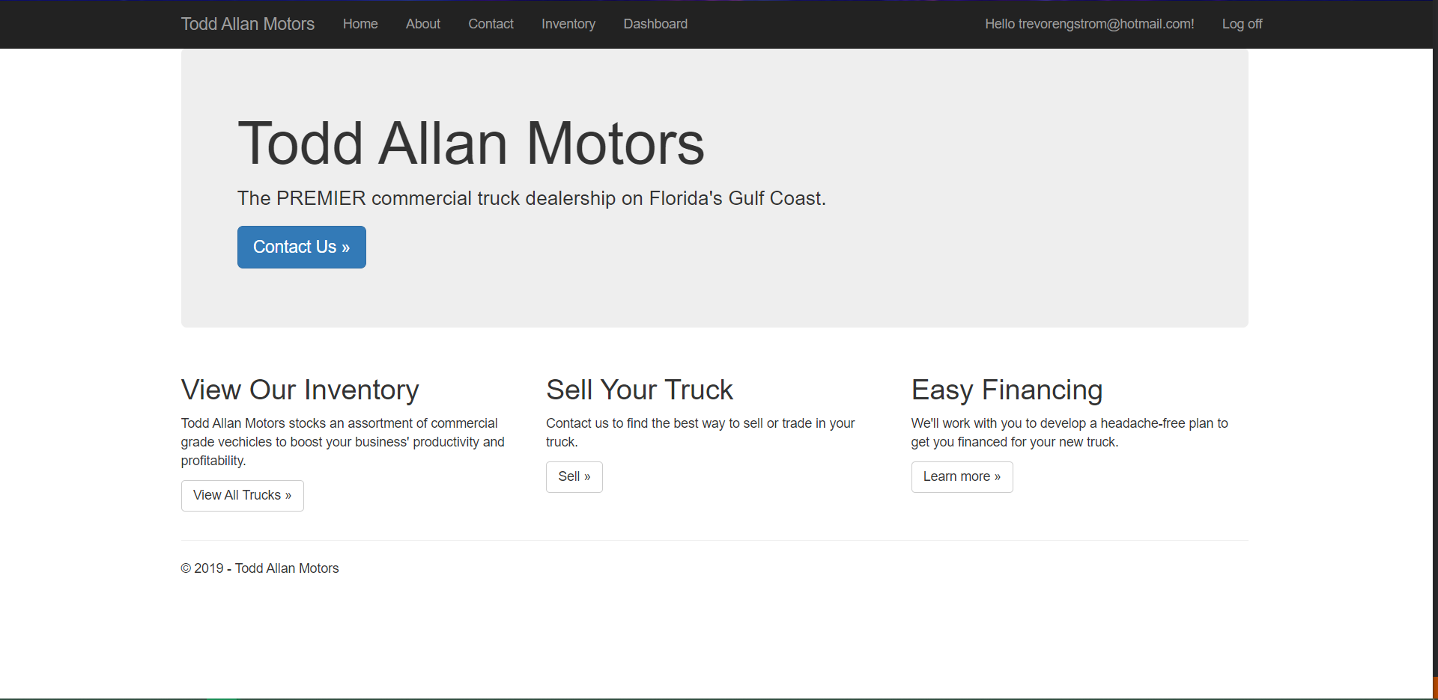

Slide 9
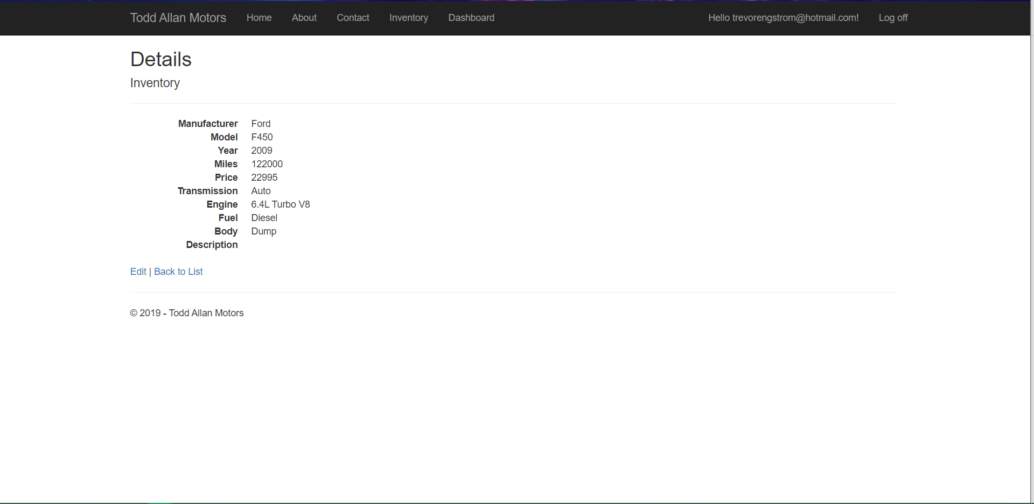

Slide 10
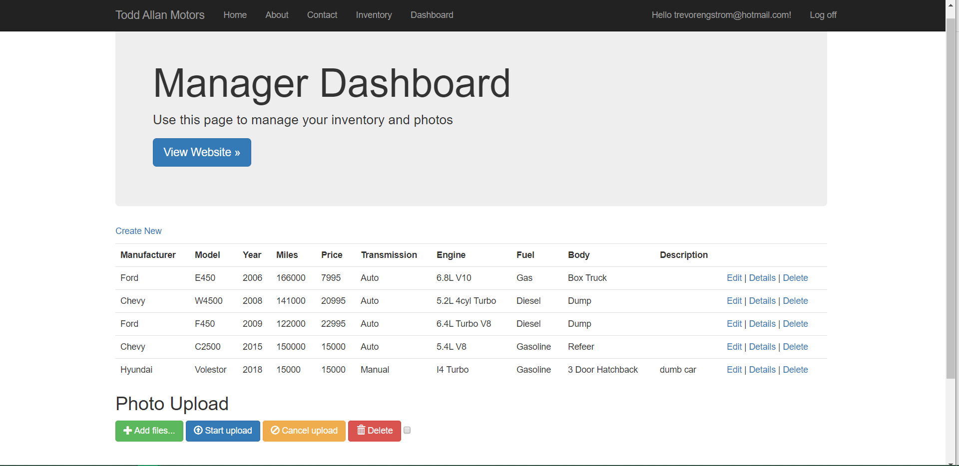

Slide 11
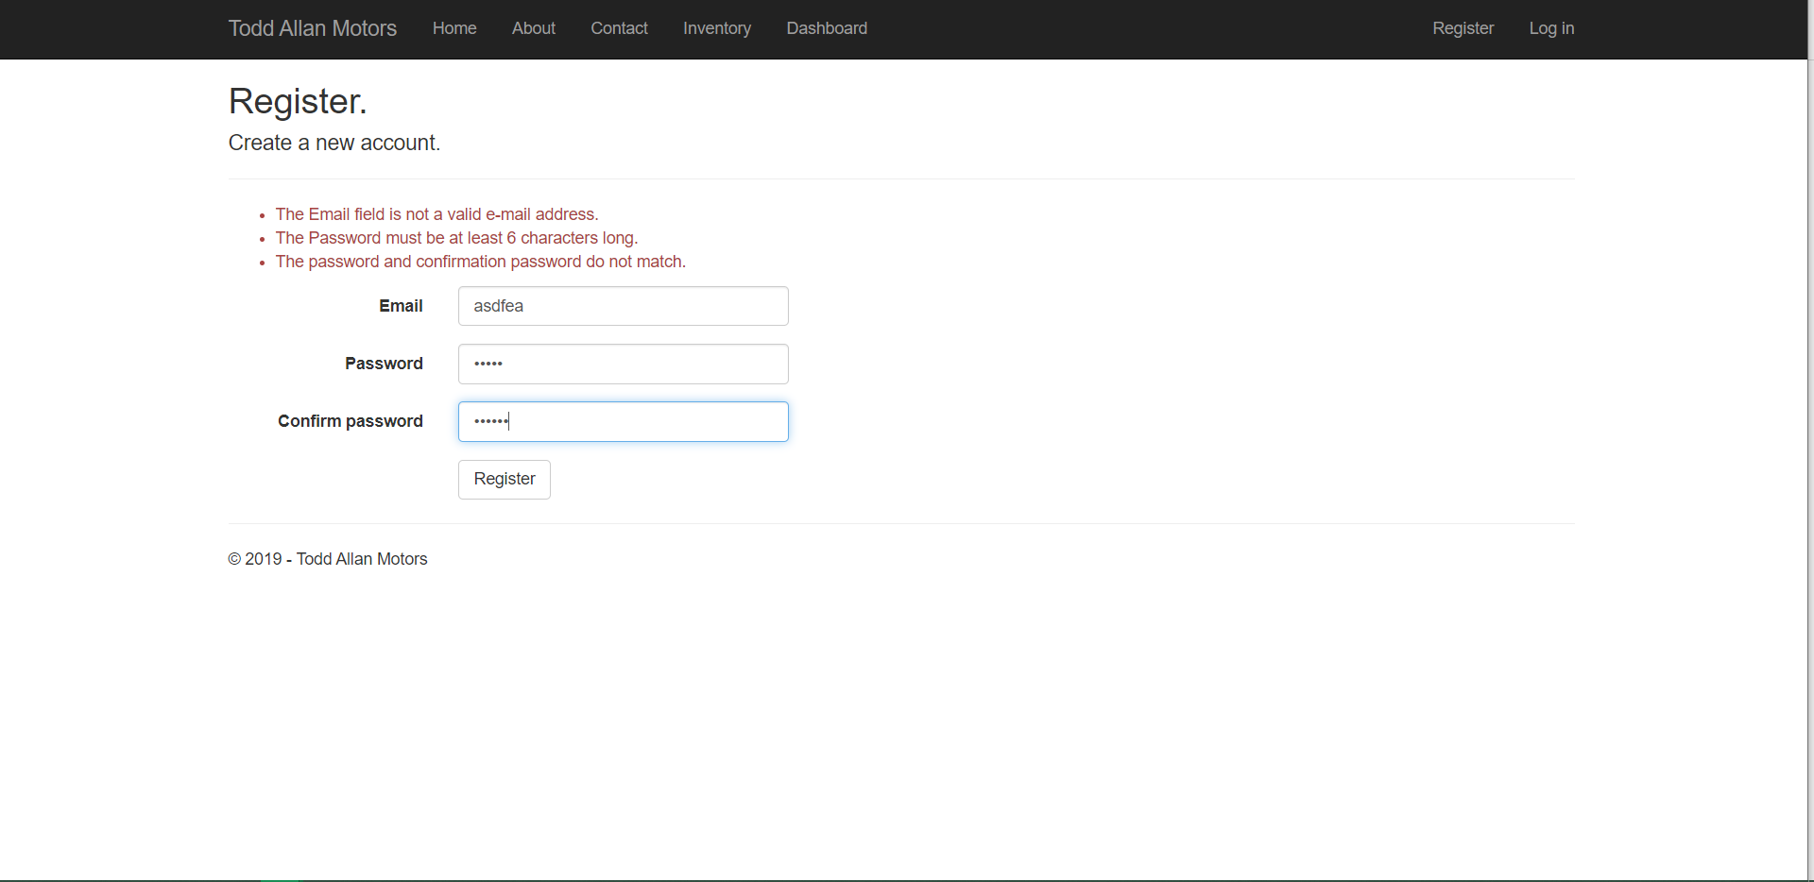

Slide 12
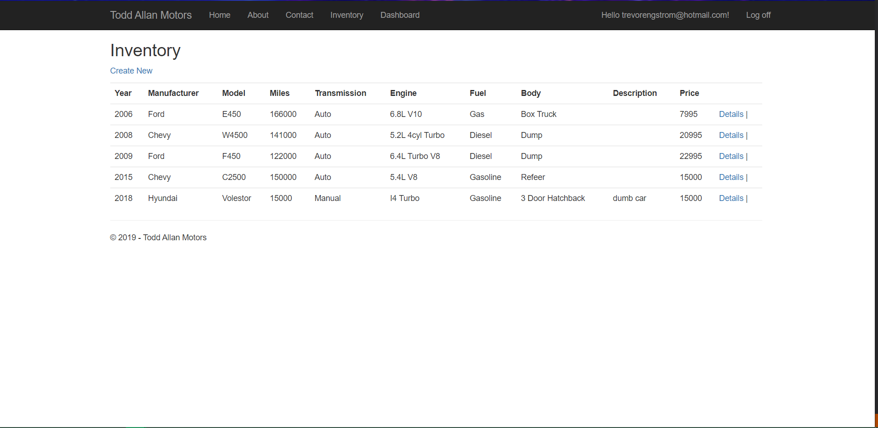

Slide 13
Questions?

